Slide 1
MOBILE UI USING ANGULAR AND IONIC
MEERA JAVAD[245217] & SANKARI SURESH [245108]

Slide 2
Developing Mobile Apps with Angular and Ionic
Mobile app development is rapidly growing, and businesses are looking for efficient frameworks to build high-quality apps.
Angular and Ionic offer a powerful combination for creating cross-platform mobile apps with a native look and feel.
This presentation will explore the benefits of using Angular and Ionic and provide a step-by-step guide to building a mobile app.

Slide 3
What is Ionic?
It is an open source mobile UI toolkit for building modern, high quality cross-platform mobile apps from a single code base in Angular, React or Vue.
Ionic Capacitor is a cross-platform native bridge that allows you to turn any web project into a native iOS or Android mobile application. Capacitor enables easy access to common device features, using basic JavaScript, with complete access to the native operating system when you need it.
Ionic Framework extends Capacitor by providing a rich library of mobile-optimized UI components—plus mobile routing, navigation, gestures, and animations. Ionic Framework works with specific JavaScript frameworks, including React, Angular, and Vue. If you’re familiar with any of these JS frameworks, you’ll feel right at home.
Ionic Portals supports the creation of mobile micro frontends that can be deployed to any existing native mobile applications, including apps built with Swift, Kotlin, React Native, and more. Portals is primarily used by enterprises to scale development by allowing multiple teams to build, test, and ship in parallel, or to deploy a single micro app across multiple applications.

Slide 4
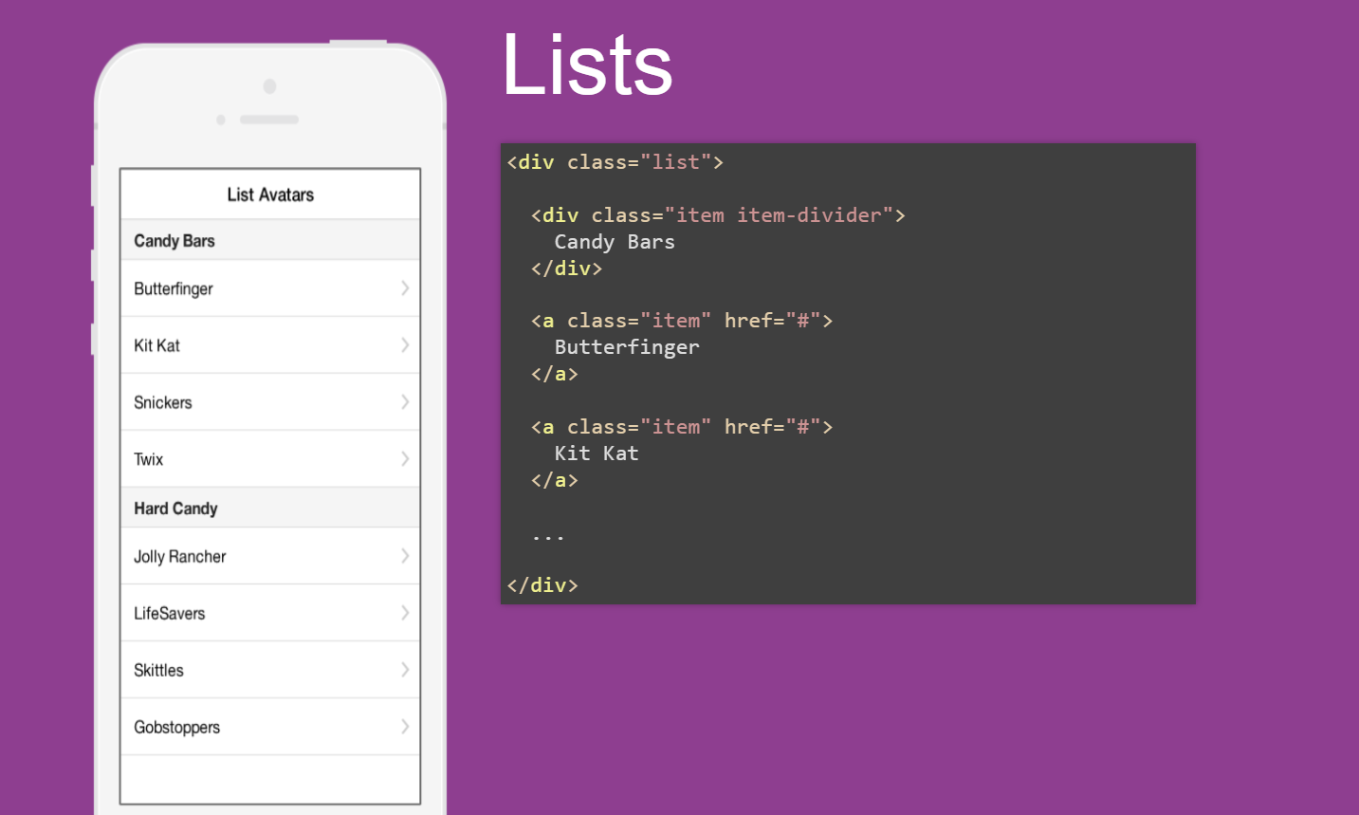

Slide 5
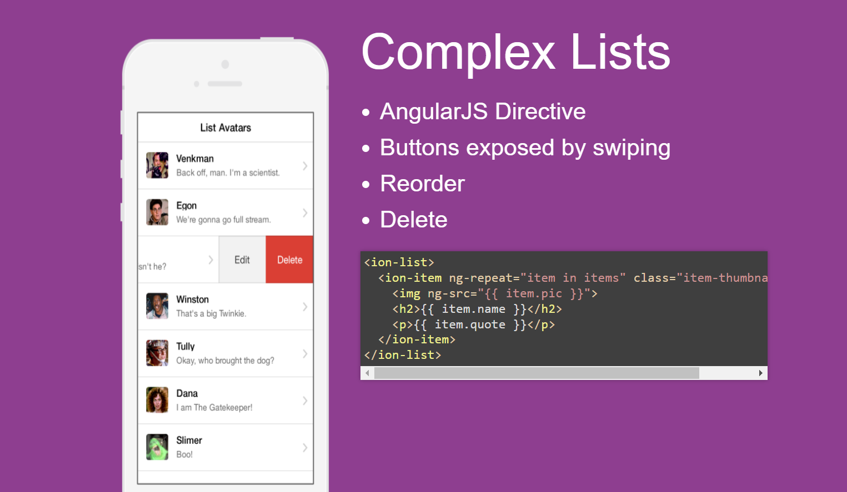

Slide 6
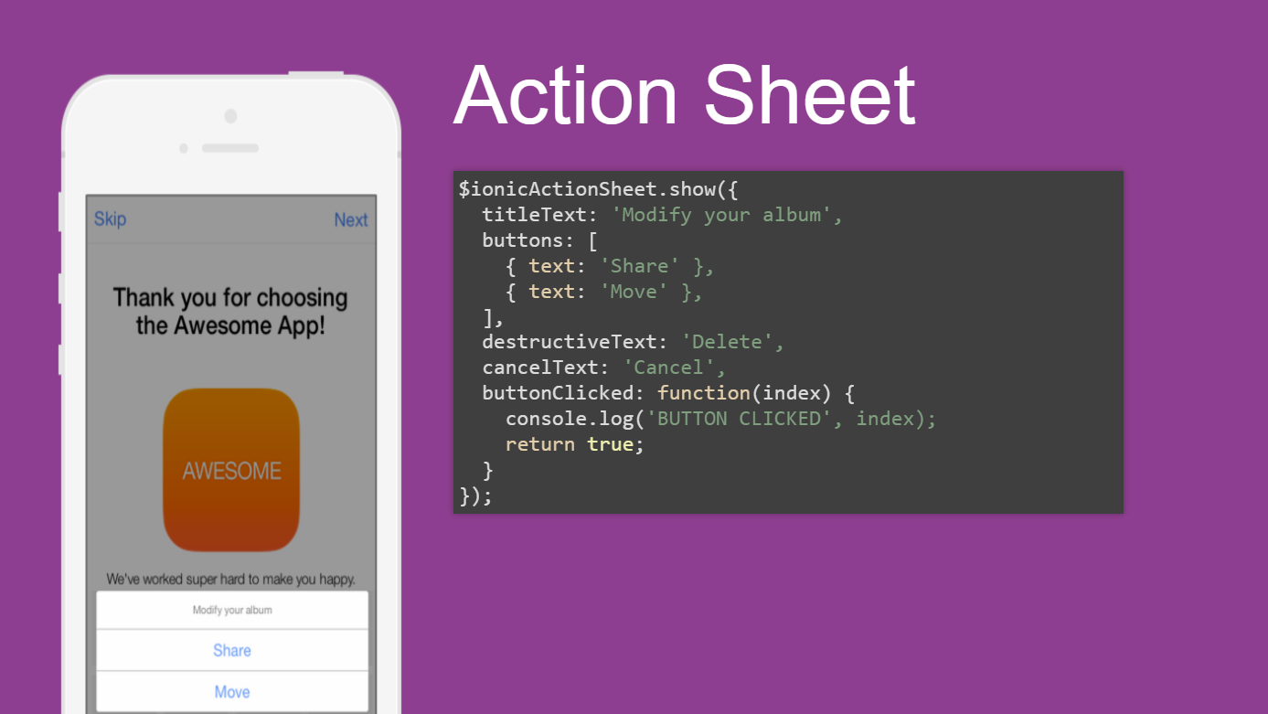

Slide 7
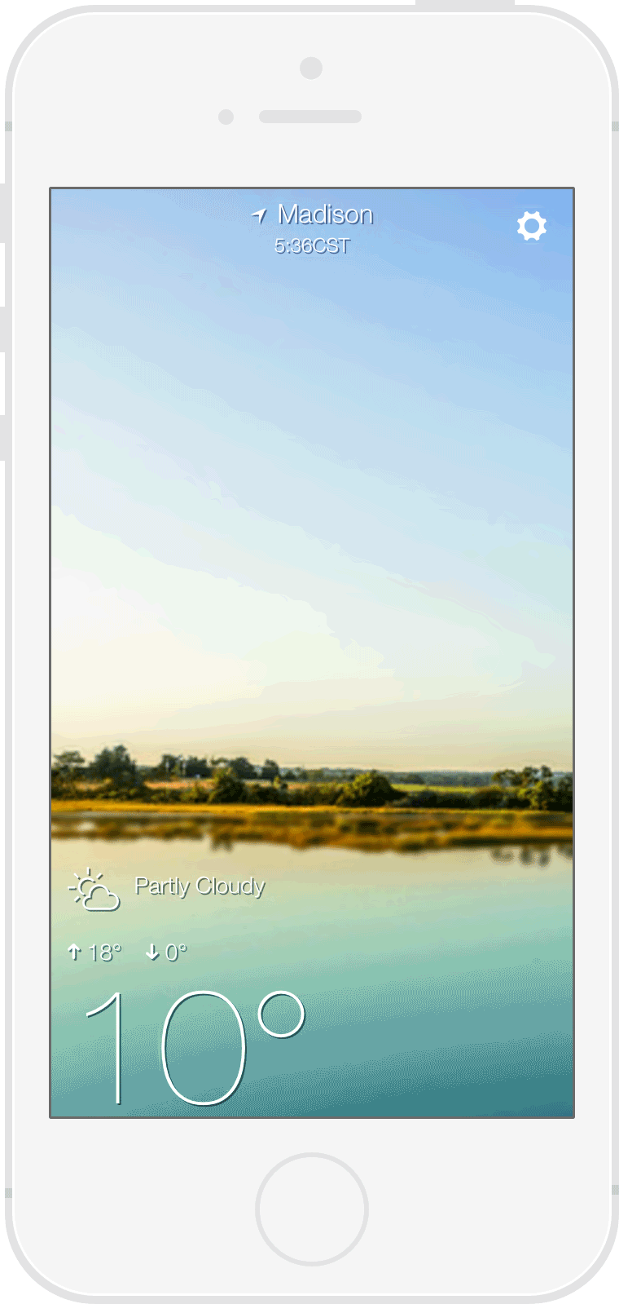
Pull to refresh
<ion-content on-refresh="refreshData()"> <ion-refresher></ion-refresher> <!-- content --> </ion-content>

Slide 8
To do list app example
Generate a New Ionic project: Run the following command for this,
ionic start ionic-todo blank.
Set up the home by creating a template.
<ion-header> <ion-navbar color="secondary"> <ion-title> Todos! </ion-title> <ion-buttons end> <button ion-button icon-only (click)="addItem()"> <ion-icon name="add-circle"></ion-icon> </button> </ion-buttons> </ion-navbar></ion-header><ion-content> <ion-list> <ion-item *ngFor="let item of items" (click)="viewItem(item)" >{{item.title}}</ion-item > </ion-list></ion-content>
3.Create the class definitions
import { Component } from '@angular/core';import { NavController } from 'ionic-angular’;@Component({ selector: 'page-home', templateUrl: 'home.html'})export class HomePage { public items; constructor(public navCtrl: NavController) { } ionViewDidLoad(){ this.items = [ {title: 'hi1', description: 'test1'}, {title: 'hi2', description: 'test2'}, {title: 'hi3', description: 'test3'} ]; } addItem(){ } viewItem(){ }}

Slide 9
To do list app example
Generate a New Ionic project: Run the following command for this,
ionic start ionic-todo blank.
Set up the home by creating a template.
<ion-header> <ion-navbar color="secondary"> <ion-title> Todos! </ion-title> <ion-buttons end> <button ion-button icon-only (click)="addItem()"> <ion-icon name="add-circle"></ion-icon> </button> </ion-buttons> </ion-navbar></ion-header><ion-content> <ion-list> <ion-item *ngFor="let item of items" (click)="viewItem(item)" >{{item.title}}</ion-item > </ion-list></ion-content>
3.Create the class definitions
import { Component } from '@angular/core';import { NavController } from 'ionic-angular’;@Component({ selector: 'page-home', templateUrl: 'home.html'})export class HomePage { public items; constructor(public navCtrl: NavController) { } ionViewDidLoad(){ this.items = [ {title: 'hi1', description: 'test1'}, {title: 'hi2', description: 'test2'}, {title: 'hi3', description: 'test3'} ]; } addItem(){ } viewItem(){ }}

Slide 10
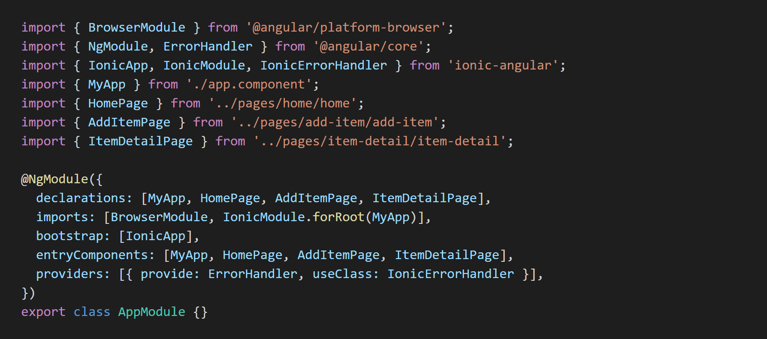

Slide 11
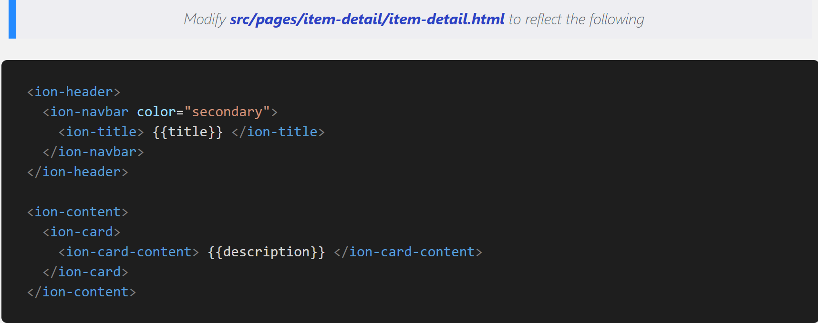

Slide 12
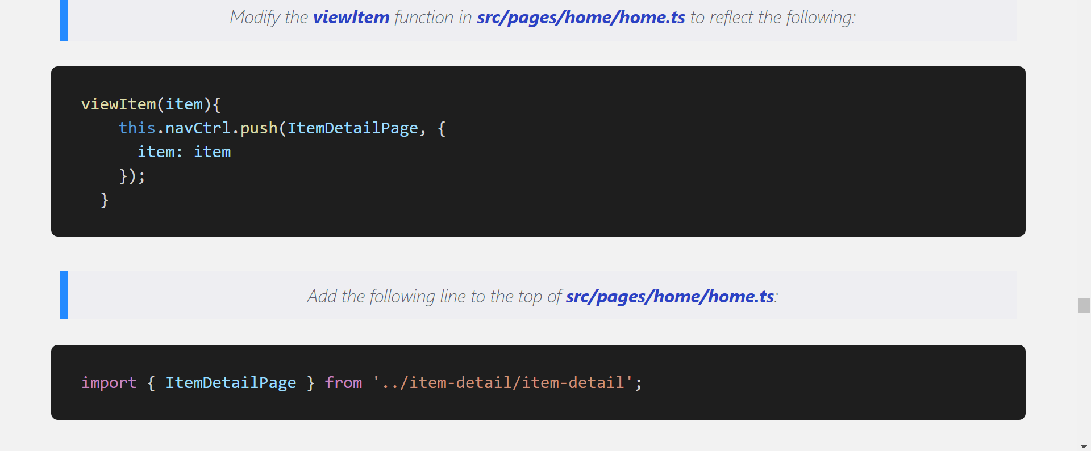

Slide 13


Slide 14
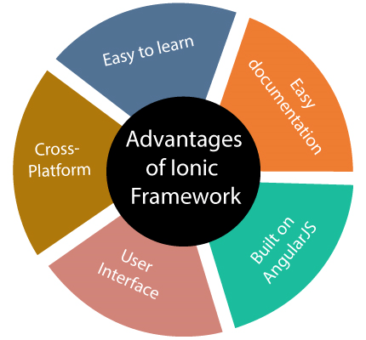
Advantages of using Ionic
1. Easy to learn
If the developer has a basic knowledge of CSS, HTML, or JavaScript frameworks, then learning and developing apps using the Ionic framework is very easy. It also allows for the development companies to switch to Ionic if their requirements and needs require hybrid application development.
2. Easy documentation
Ionic provides very good and well-structured documentation. The official documentation covered most of the things required for the developers.
3. Cross-platform
The ionic application can deploy on multiple platforms such as native iOS, Android, Desktop, and the web, all with one codebase. These applications can write once and runs everywhere.

Slide 15
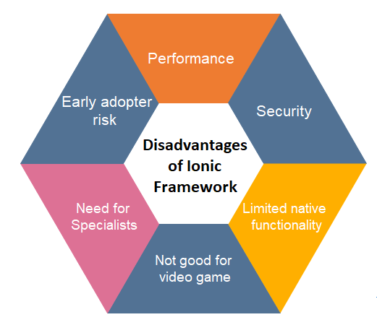
Disadvantages of using Ionic
1. Performance
The performance of the Ionic application is not as good as compared to native mobile applications. However, the performance gap is not noticeable for most of the average users.
2. Security
The app developed with the Ionic framework may not provide as much security as a native application. For example, if you are developing a financial app, e.g., the app for a bank, the Ionic framework is not recommended.
3. Limited native functionality
There are some native functions may not be available in the Ionic framework. In such a case, you need to develop the plugin to fulfill that function yourself. However, there are many plugins available to cover most of the native functionalities.

Slide 16
4. Not good for video game
Ionic framework is not perfect for high-end graphics-dependent applications or video games.
5. Need for specialists
JavaScript can be tricky to learn. So, there is a need for someone who can not only "do" JS, but also have deep knowledge of advanced libraries and technologies including Angular, Cordova, Ionic, etc.
6. Early adopter risk
Ionic technology is still in development. It regularly keeps changing its support and standard, and its libraries can be completely rewritten at any time.

